Slide 1
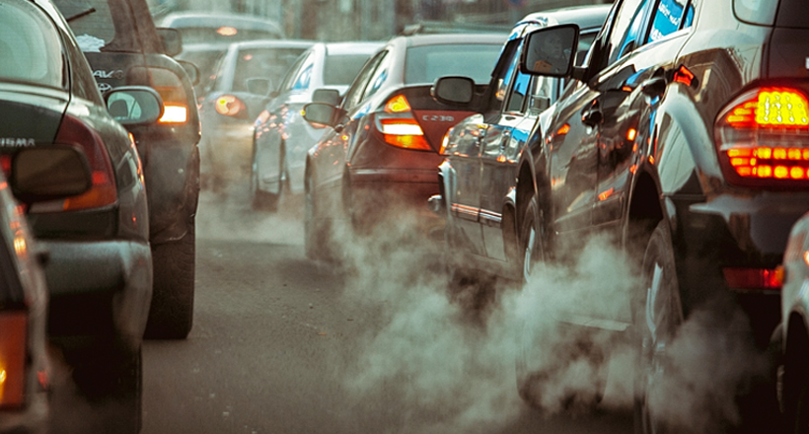

Predicting CO₂ Emissions by vehicles using Regression.
Final Project Presentation: BUS 510 Business Analytics & Decision Modeling (Fall 2025)
Presented by: Janhavi Gurav, John Ponnett, Leona Strine

Slide 2
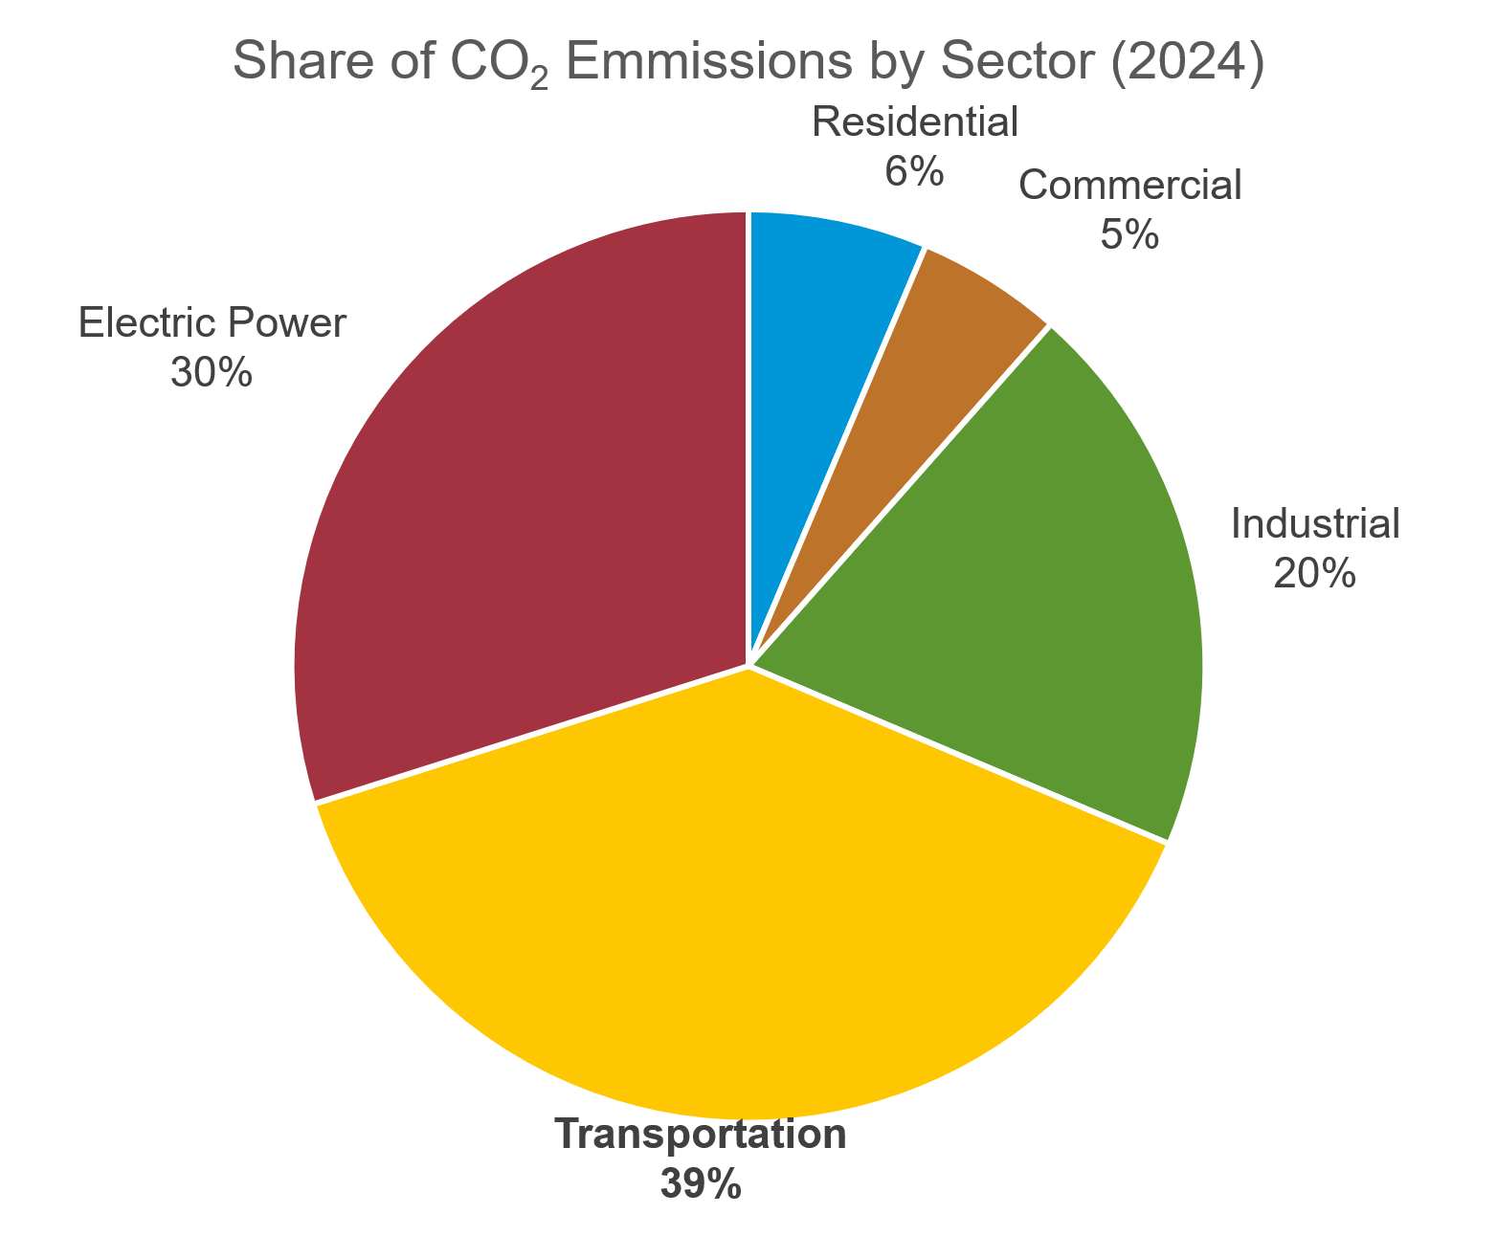
Problem Statement
Transportation is one of the largest contributors to greenhouse gas emissions
Environmental policy is a complex challenge faced by numerous stakeholders globally, including governments, automative manufacturers, and environmental agencies
Consumers are growing increasingly conscious of the impact of their individual choices on the environment
Objective: Use multiple linear regression to create a model to predict carbon dioxide emissions based on a series of vehicle-specific characteristics and understand which cause the largest impact
Source: US Energy Information Administration

Slide 3
Data Collection Source
Data was accessed through Kaggle.
Data was published by the Canadian Government as part of their natural resources and environmental reporting.
Contains variables such as make, car model, vehicle class, fuel types, engine characteristics, fuel consumption ratings, and certified CO₂ emissions for multiple vehicle models.
Data was clean, but required:
Dummy variable creation
Elimination of redundant predictors
Randomized splitting for cross-validation

Slide 4

Variable Selection
Dependent Variable (Y):
CO₂ Emissions (g/km) — actual emissions measured by regulatory agencies.
Independent Variables (X):
Fuel Consumption Combined (L/100 km)
This variable indicates the fuel consumption combined on highways and in cities. (Individual values for highway & city mentioned in the data sheet.)
Strongest theoretical predictor of emissions (direct relationship).
Engine Size (L)
Larger engines burn more fuel → more emissions.
Transmission Type (Dummy Variables):
The values are converted into A6, A8 → Automatic, M5, M6, M7 → Manual, AM6, AS5, AV7 → Semi-Automatic & then turned into dummy variables.
Trans_Manual (1 = manual, 0 = otherwise)
Trans_SemiAuto (1 = SemiAuto, 0 = otherwise)
Automatic becomes baseline.
Fuel Type (Dummies):
D → Diesel, E → Ethanol (E85) , N → Natural gas, X → Premium Gasoline, Z → Regular Gasoline
Dummy variables: Fuel Type_D, Fuel Type_E, Fuel Type_Z, Fuel Type_X

Slide 5
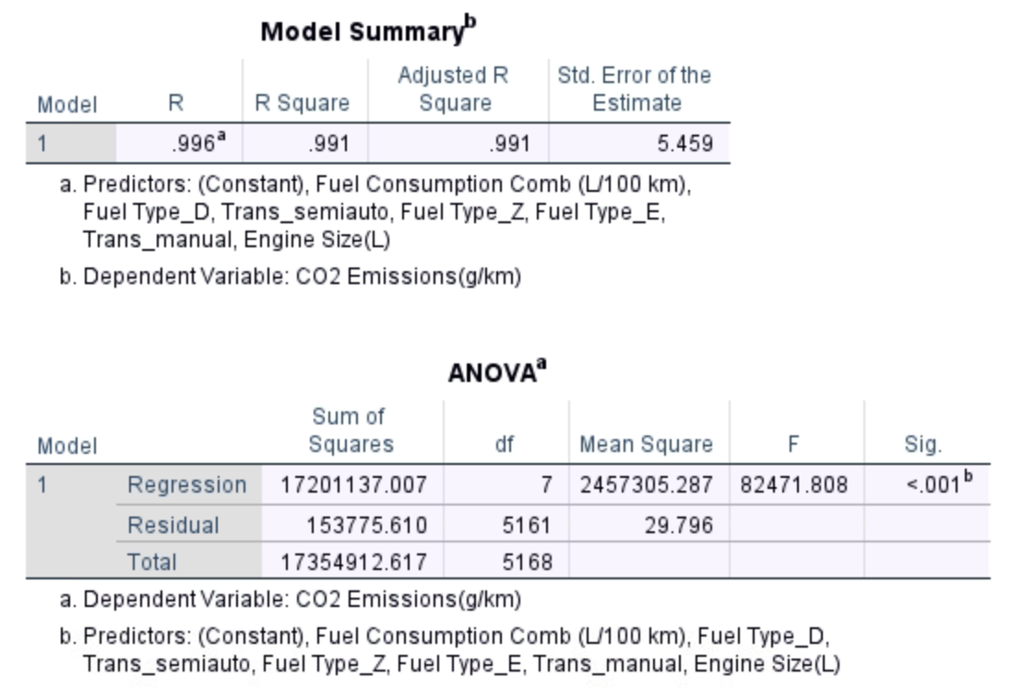
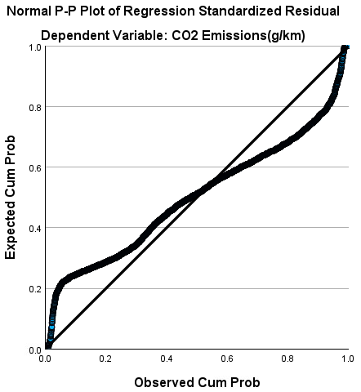
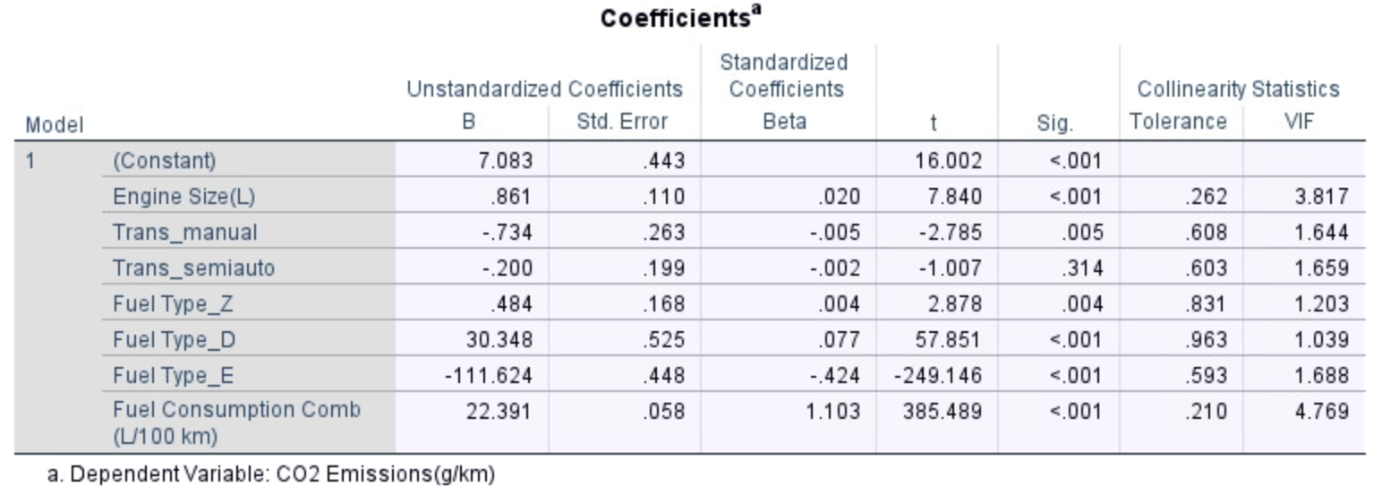
Tests: Significance & Normality
Significance F < 0.001 is less than alpha of 0.05 -> Model is Significant as a whole
P-values are less than alpha of 0.05 for all included independent variables except Transmission Semi-Automatic. All other variables are Significant

Slide 6
Tests: Multicollinearity
No independent variables exhibit high or moderate multi collinearity (all VIF < 5.000)
Earlier proposal included number of engine cylinders, but this caused multi collinearity with the Engine Size variable, so Cylinders was discarded

Slide 7
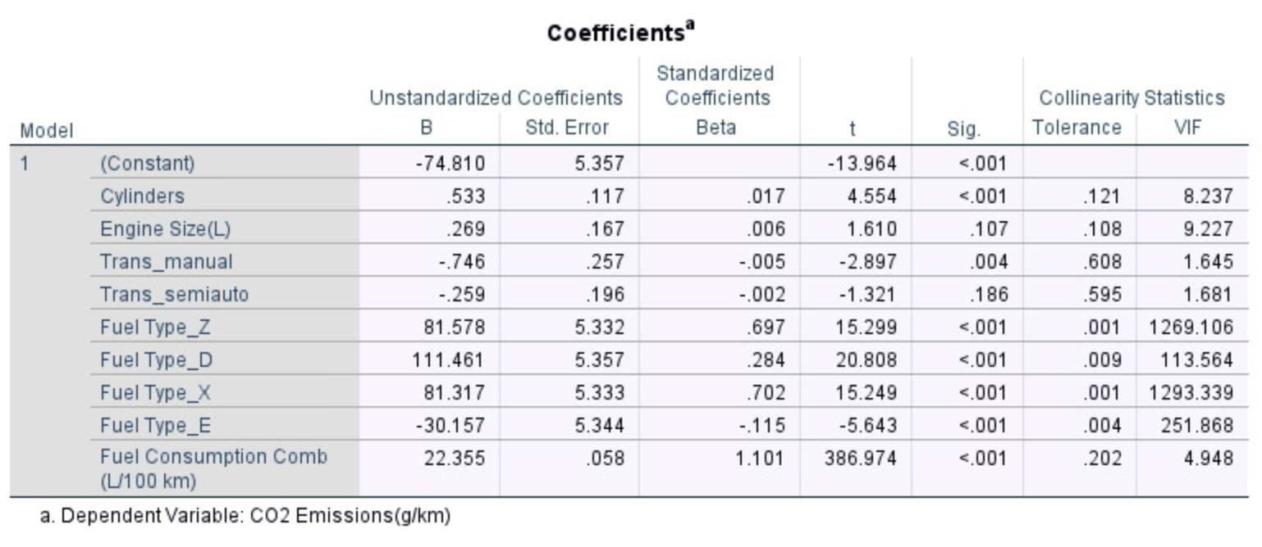
Hypothesis Testing
H₀: Independent variables do NOT significantly predict CO₂ emissions. H_{A}: At least one variable significantly predicts CO₂ emissions.
Significant Predictors (p < 0.05):
Fuel Consumption (strongest)
Engine Size
Fuel Type D
Fuel Type E
Transmission Manual (p = .005)
Insignificant Predictors:
Transmission SemiAuto
Result: Reject H₀ — variables DO significantly predict emissions.

Slide 8
Predictive Analytics Model and Analysis
Training Model Results
R² = .991
99.1% of the variation in dependent variable, CO₂ Emissions, is explained by the seven independent variables.
Estimated Multiple Linear Regression Equation: Y = 7.083 + 0.861(x_{Engine Size}) - 0.734 (x_{Trans_Manual}) - 0.200(x_{Trans_Semiauto}) + 0.484(x_{Fuel Type_Z}) + 30.348(x_{Fuel Type_D}) - 111.624(x_{Fuel Type_E}) + 22.391(x_{Fuel Consumption Comb})

Slide 9
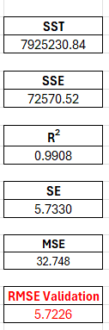

Predictive Analytics Model and Analysis
Validation Model Results
R² had little variance between the training and validation model.
Training R²: 99.10%
Validation R²: 99.08%
RMSE had little variance between the training and validation model.
Training RMSE: 5.4543
Validation RMSE: 5.7226
Standard Error had little variance between the training and validation model.
Training SE: 5.459
Validation SE: 5.733
Conclusion: The validation model suggests the estimated multiple linear regression equation is a good fit to explain the variation in CO₂ emissions.
RMSE Training
5.4543

Slide 10
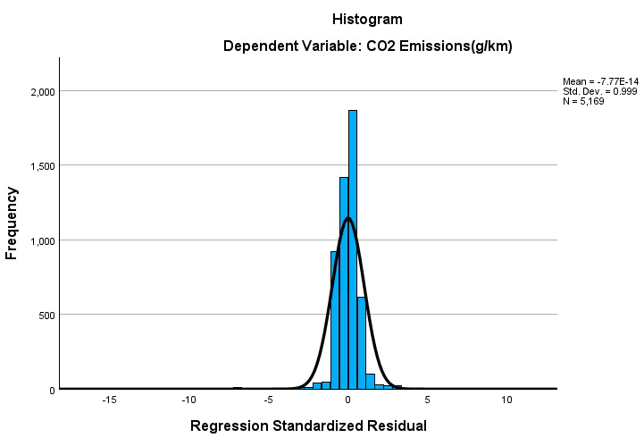
Analysis of Residuals
Linearity Holds: random dispersion of residuals around horizontal axis
Homoscedasticity Holds: constant spread around horizontal axis
Normality Holds: histogram of residuals follows bell-shaped curve
Independence Holds: no cyclical or alternating pattern of residuals

Slide 11
Conclusion and Lessons Learned
Fuel consumption is the strongest predictor of CO₂ emissions- Vehicles that burn more fuel emit substantially more CO₂.
Engine Size contributes, but less than expected- Larger engines increase emissions slightly.
Fuel Type changes emissions dramatically
Diesel (D): Higher emissions than baseline fuel (X).
Ethanol/E-fuel (E): Significantly lower emissions.
Fuel chemistry impacts CO₂ more than the transmission.
Transmission type has minimal environmental impact- Manual transmissions reduce emissions slightly.
Emissions relationships are naturally linear- CO₂ output aligns closely with physical combustion principles.
Fuel Consumption has a direct linear relationship with CO₂, that’s why R² is naturally very high.
Data preprocessing often matters more than modeling. Fixing multicollinearity, removing redundant predictors, and creating proper categories are the steps which improved the model.

Slide 12
Future Directions
Explore the impact of removing and swapping independent variables from the model to analyze the impact on R².
Example: Removing x_{Trans_SemiAuto} from model due to being identified as an insignificant variable.
Example: Swap Engine Size variable for Cylinder variable.
Example: Swap dummy variables.
Questions and Feedback?

